Slide 1
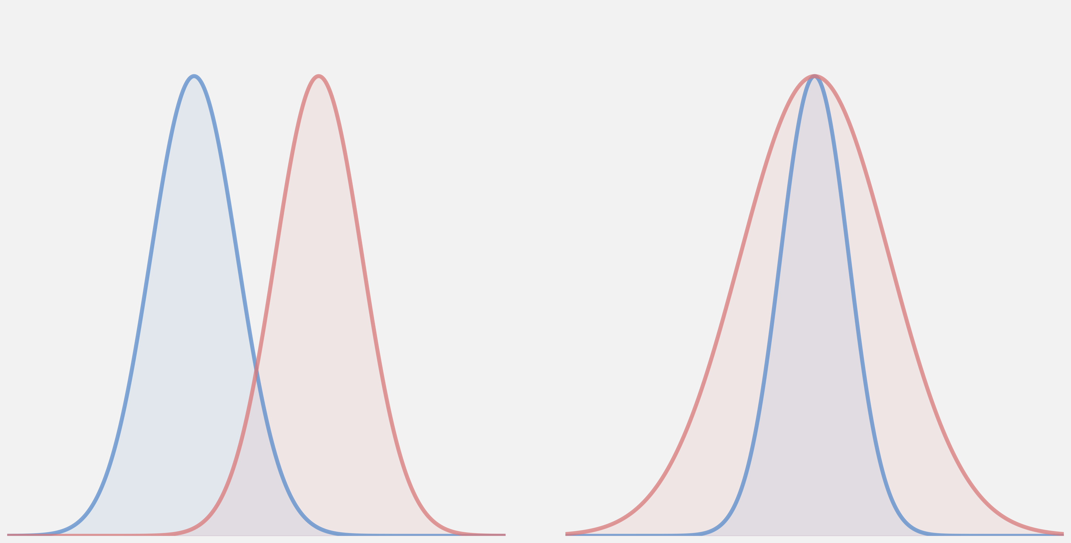
Switching Rules and Mismatch Dynamics in Context-Dependent Encoding
Name: Sallam Saka
Course: PHY431 – Topics in Biological Physics
Professor: Professor Sidhartha Goyal

Slide 2
Efficient Coding in Changing Environments
Efficient coding: sensory systems allocate limited resources to represent their environment efficiently.
Many classical works on efficient coding assume a stationary stimulus distribution (Laughlin 1981).
In real environments, context changes and must be inferred in time as data arrives.
Inference errors can produce mismatch between the selected and true code.
Therefore, local optimality need not imply global optimality (Młynarski and Hermundstad, 2021).
Notes:
Effiicient coding is an hypothesis that states that sensory systems are adapted to efficiently represent the environment under biological constraints.
Classic quantitative work has shown how neural response properties can be efficiently matched to stimulus distributions (Laughlin 1981).
However, natural environments are non stationary and sensory systems must continually adapt.
In their paper, Młynarski and Hermundstad study how sensory systems should adapt its encoding to dynamic environments given its inferred context (i.e. inferred current environmental state).
They found that due to possible error in context inference, the locally optimal solution based on each inferred context does not necessarily minimize long-run global error but biasing the parameters of the locally optimal solutions towards more robust improves global performance.

Slide 3
How Do Switching Rules Affect Performance When Context Is Inferred?
Context Inference alone does not determine when encoding changes.
The system must decide when to adopt the inferred context.
Switching rules impose different levels of stability.
I compare two conservative switching rules:
Hysteresis: requires stronger evidence to switch than to stay.
Refractory lockout: temporarily prevents switching after a recent switch.
Notes:
I build on Młynarski and Hermundstad by adding a second layer to encoding choice, where even given an estimated context, the system still has to decide when to switch codes.
Rather than assuming immediate adoption of the inferred context, In my research, I compare two specific conservative switching rules, hysteresis and refractory lockout.
Hysteresis is used here as a simple model to enforce stability. It forces the organism to reach an evidence threshold before changing its encoding function.
Refractory lockout is included as a simple model of the reduced responsiveness that follows recent neural activity. This is loosely motivated by the fact that neurons often show a refractory period after an action potential.

Slide 4
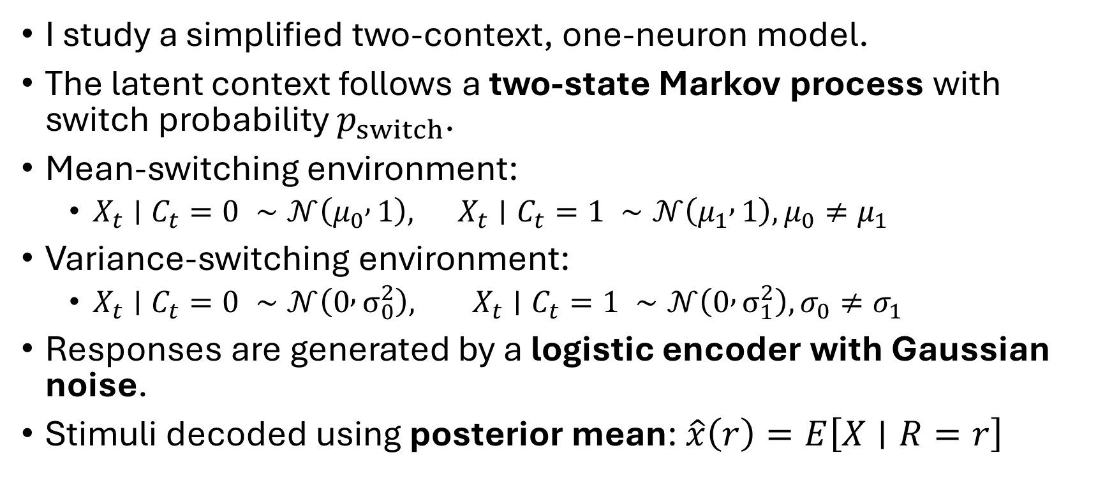
Sequential Model of Context Inference and Encoding
I study a simplified two-context, one-neuron model.
The latent context follows a two-state Markov process with switch probability $p_{switch}$.
Mean-switching environment:
$X_{t}∣C_{t}=0 ∼𝒩\left(μ_{0} , 1\right), X_{t}∣C_{t}=1 ∼𝒩\left(μ_{1} , 1\right), μ_{0}≠μ_{1}$
Variance-switching environment:
$X_{t}∣C_{t}=0 ∼𝒩\left(0 , σ_{0}^{2}\right), X_{t}∣C_{t}=1 ∼𝒩\left(0 , σ_{1}^{2}\right), σ_{0}≠σ_{1}$
Responses are generated by a logistic encoder with Gaussian noise.
Stimuli decoded using posterior mean: $\hat{x}\left(r\right)=E\left[X∣R=r\right]$
Notes:
I also consider 2 different environments which define the 2 contexts being switched between. The mean…
Response gaussian centered at zero with standard deviation of 0.18
Parameters optimized numerically

Slide 5
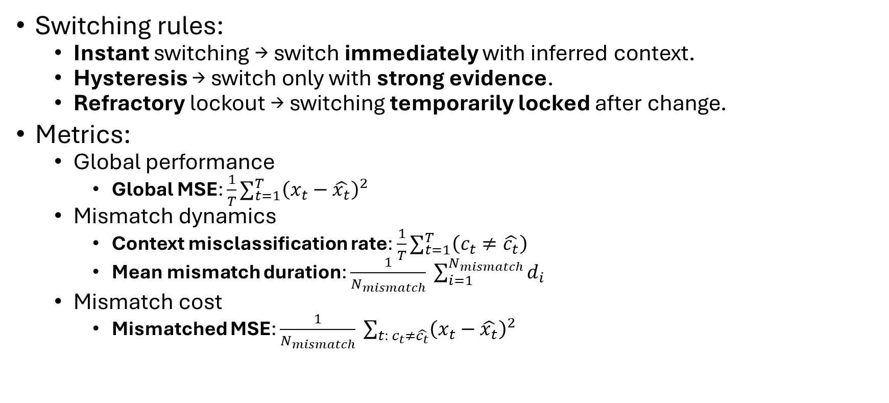
Switching Constraints and Mismatch-Based Metrics
Switching rules:
Instant switching → switch immediately with inferred context.
Hysteresis → switch only with strong evidence.
Refractory lockout → switching temporarily locked after change.
Metrics:
Global performance
Global MSE: ${\frac{1}{T}∑}_{t=1}^{T}{\left(x_{t}−\hat{x_{t}}\right)}^{2}$
Mismatch dynamics
Context misclassification rate: ${\frac{1}{T}∑}_{t=1}^{T}\left(c_{t}≠\hat{c_{t}}\right)$
Mean mismatch duration: $\frac{1}{N_{mismatch}} \sum_{i=1}^{N_{mismatch}}{d_{i}}$
Mismatch cost
Mismatched MSE: $\frac{1}{N_{mismatch}} \sum_{t: c_{t}≠\hat{c_{t}}}{{\left(x_{t}−\hat{x_{t}}\right)}^{2}}$
Notes:
I study the effects of the switching rules using 4 metrics
For hysteresis, I require the posterior probability of the alternative context to exceed a threshold before switching, and in my main simulations I set that threshold to 0.65. For refractory lockout, once a switch occurs, further switching is blocked for a fixed number of steps, which I set to 5 in the baseline simulations.

Slide 6
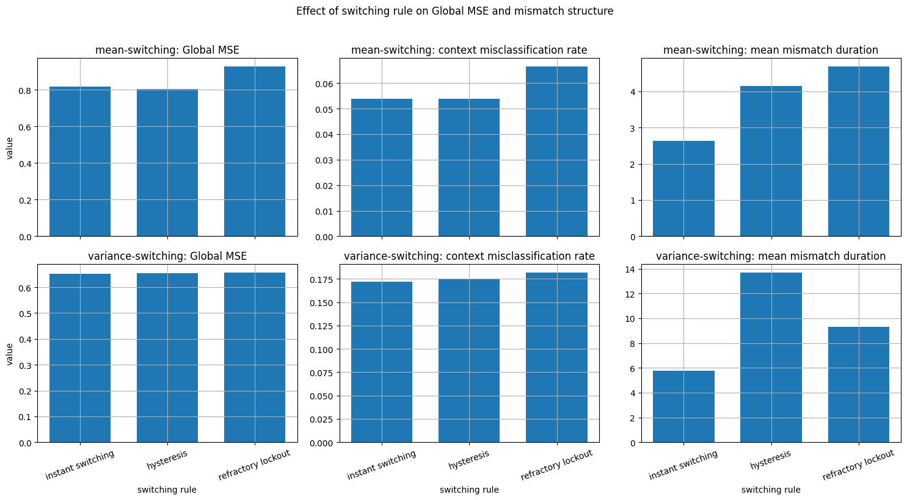
Global Performance Depends on Switching Rule
Notes:
Maybe highlight how variance switching global/mismatch mse tends to be lower in general and higher for rate and duration
Guessing context for variance switching very hard but mse not that bad?
Mmismatch MSE mostly same
Another thing I would like to draw your attention to is… in themean switching environment,…
Misclassificaiton rate being rly diff for refractory shows that hysteresis seems to mostly act as a stabilizing mechanism rather than forcing misclassification. Refractory forces misclassification regardless of confidence. However, This pattern is less pronounced in the variance switching environment
The main result I would like to highlight is this…
Maybe hysteresis mismatch duration cus lack of confidence
I think the most important thing to take from these is:
Together, these results indicate that switching rules primarily modulate how mismatch is distributed over time, while their effect on overall error depends on the environment. Which will be ofcused on in subsequent analysis

Slide 7
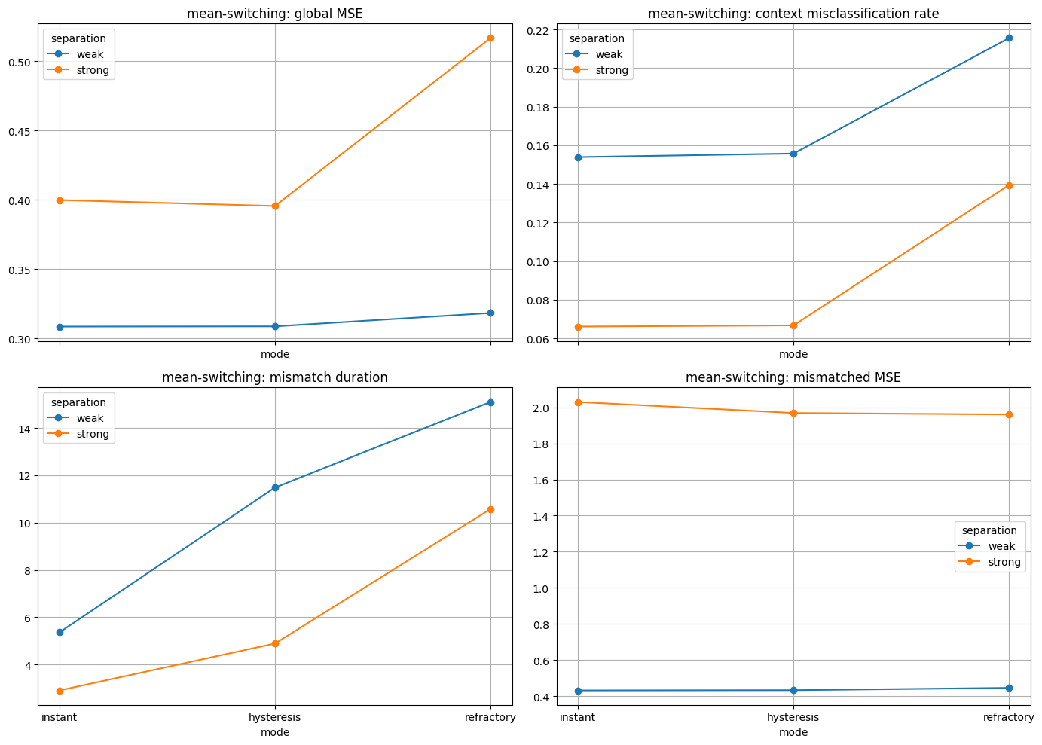
Mismatch Has Different Consequences Across Environments
Strong separation: ↓ mismatch rate and duration.
Strong separation: ↑ error when mismatch occur.
Global performance: (how often mismatch happens) × (how costly it is.
Notes:
Having established that switching rules primarily affect the temporal dynamics of mismatch, I then examine how the environment mediadtes the effect of switching rule on global performance.
Due to increased bias
Mean differenc eof 2 compared to 0.75 and variance difference of 1.1 instead of 0.5
From the top right and bottome left plots

Slide 8
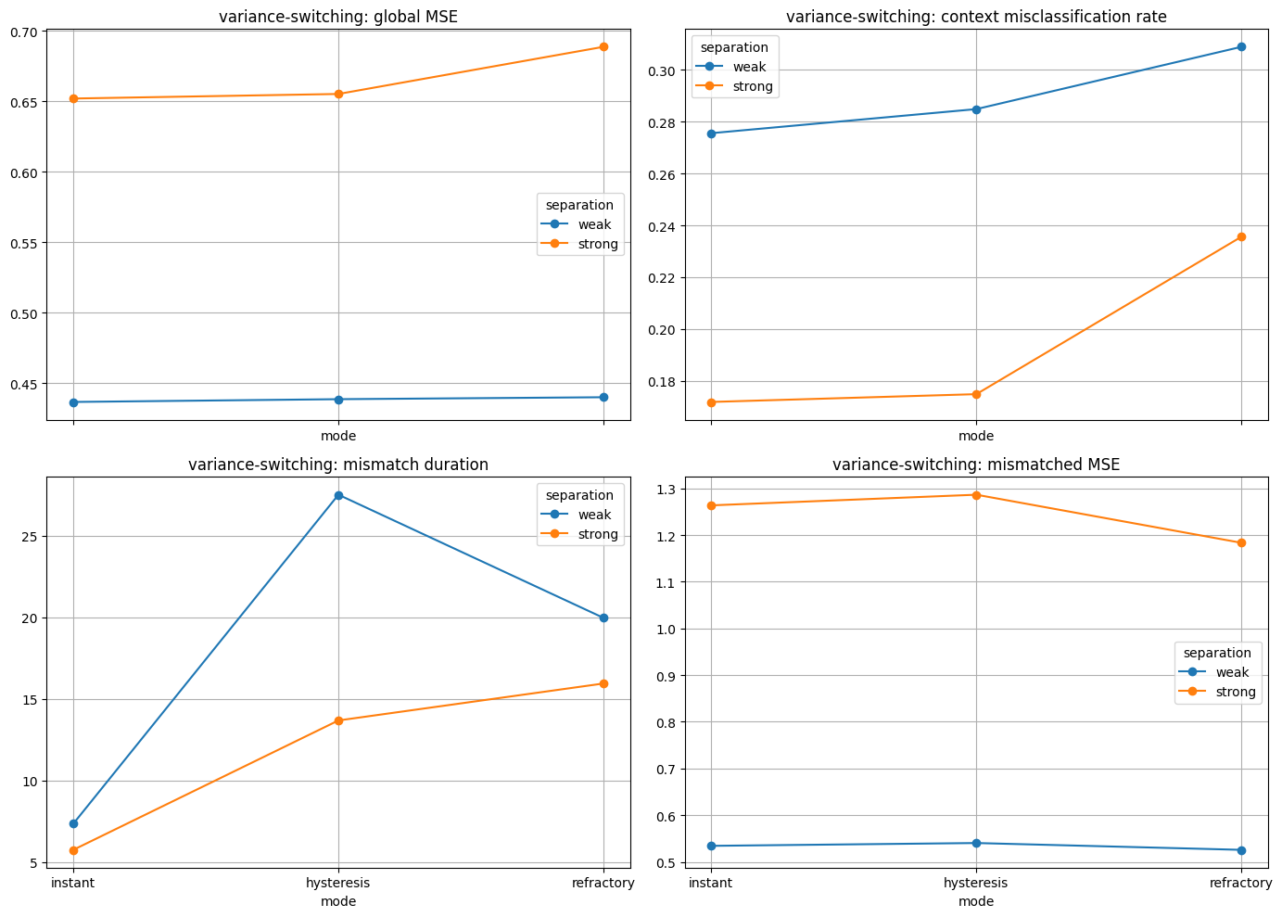
Mismatch Has Different Consequences Across Environments
Strong separation: ↓ mismatch rate and duration
Strong separation: ↑ error when mismatch occur
Global performance: (how often mismatch happens) × (how costly it is)
Notes:
Together, these results show that context similarity modulates the impact of switching rules through two opposing effects. When contexts are more strongly separated, switching rules operate in a setting with fewer and shorter mismatch episodes, but those mismatch episodes become more costly when they occur. This is especially important for refractory lockout where you have no choice but to make the errors even I you are confident it is the wrong context. The effect of switching rule on global performance therefore depends on how context similarity shapes both the temporal dynamics of mismatch and the penalty associated with using the wrong code.

Slide 9
Switching Rules Affect Performance Through Mismatch Dynamics
Switching rules shape mismatch dynamics (rate & duration).
Differences in global MSE arise from these changes, not from mismatched MSE.
Mismatch cost depends on how context shapes the stimulus distribution.
Switching redistributes error over time, rather than changing its magnitude.
Switching affects performance by shaping mismatch over time, and the cost of that mismatch depends on the environment.
Notes:
These results suggest that biological constraints on switching can shape performance by altering mismatch over time.
Mismatch cost depends on how context shapes the stimulus distribution which depends on the environment, so, in the Mean-switching environment, mismatch introduces bias which increases error for each mismatch while Variance-switching mismatch alters uncertainty which alters how close or far from the center our decoded stimuli estimate is
The results show that switching rules primarily affect performance through their impact on mismatch dynamics. Across both environments, differences in global MSE are explained by systematic changes in mismatch rate and mean mismatch duration, while mismatched MSE remains comparatively stable. This indicates that switching rules do not substantially alter the magnitude of error incurred during mismatch, but instead control how often mismatch occurs and how long it persists. As a result, global performance is determined not only by encoding quality, but by the temporal structure of mismatch.
Importantly, the decomposition of global error reveals that performance differences are driven primarily by changes in mismatch rate and duration rather than changes in mismatched MSE. Because mismatched MSE is relatively invariant across switching rules, the dominant effect of switching is to redistribute error over time.
In the mean-switching environment, mismatch produces a systematic bias in the decoded stimulus, leading to large errors that accumulate over prolonged mismatch periods. In contrast, in the variance-switching environment, mismatch primarily alters uncertainty without introducing a strong bias, resulting in a different relationship between mismatch dynamics and global error.
these results show that the cost of mismatch depends on how context influences the stimulus distribution.
These results extend classical efficient coding frameworks, which assume a known and stationary stimulus distribution (e.g., Laughlin, 1981; Ganguli and Simoncelli, 2014). In such settings, locally optimal encoding is sufficient to minimize error. However, when context must be inferred online, performance depends not only on encoding within each context but also on how context is inferred and how switching is implemented over time.

Slide 10
Toward Adaptive Coding in More Realistic Environments
The current model is simplified (single neuron, binary contexts, fixed switching rules).
Important extensions: population codes, richer contexts, context-dependent switching.
Switching constraints should have plausible biological analogs.
In general, these extensions would bring the model closer to the forms of adaptation expected in natural environments.
Notes:
Right now, the model assumes extremely simplified structure — a single neuron and only two contexts. This makes switching decisions very clean, but real sensory systems operate in more complex environments.
With population codes, different neurons can specialize to different parts of the stimulus or different contexts, which may reduce mismatch impact but also introduce coordination challenges in switching.
Another possible extension is having more complex contexts whether that’s by adding more than two contexts or changing the stimulus distributions
Or studying other switching rules or complicating the current switching rules ot be context dependent or something
the present model relies on several simplifying assumptions, including a single-neuron encoding scheme, a binary context structure, and fixed switching dynamics.
The constraints imposed by switching rules have natural parallels in biological systems, where encoding properties do not change instantaneously in response to environmental variation.
My research can be extended in many different directions, however, I believe some of the most important ones are:
extending the one neuron framework to a population of neurons which allows for a specialization generalization tradeoff thing,
more environments with obe or more complex or continuous context structures
or adaptive switching rules would provide a more complete account of sensory processing in natural environments.
Or going more in the mlynasry nd hermundstad direction and studying how the efficient codes change based on switching ruleIn
In general, further extensions should align the model more with what is to be expected in natural environments and
These extensions would bring the framework closer to what we would expect in natural environments.

